Slide 1
Entity and JPA Annotations Overview
Java Persistence API (JPA) provides ORM mapping for Java applications.
The @Entity annotation maps a class to a database table.
JPA provides a standard for object-relational mapping (ORM) in Java applications, and this annotation specifies that a class will be mapped to a database table.

Slide 2
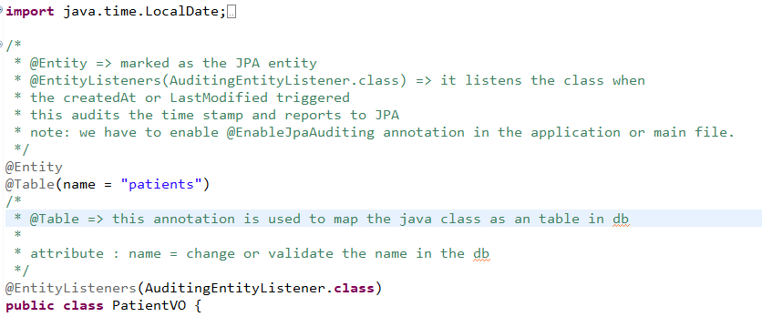
@Entity Annotation
@Entity marks a class as a JPA entity.
Maps the class to a database table.

Slide 3
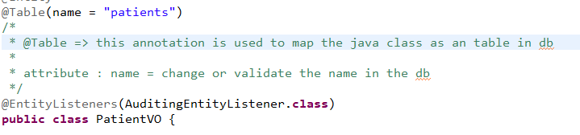
@Table Annotation
Specifies the table associated with a JPA entity.
Useful when class name differs from table name or schema is custom.

Slide 4
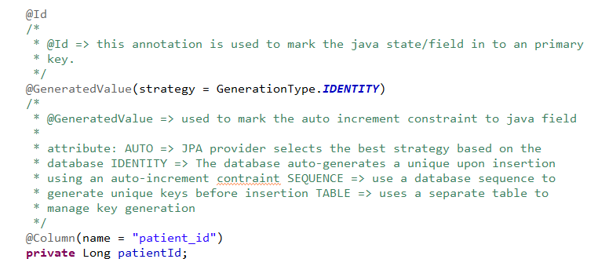
@Id and @GeneratedValue Annotations
@Id marks a field as the primary key.
@GeneratedValue auto-generates primary key values.
Strategies: AUTO, IDENTITY, SEQUENCE, TABLE.

Slide 5
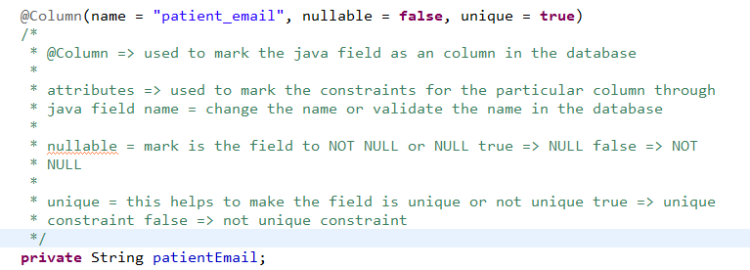
@Column Annotation
Maps a field to a database column.
Attributes: name, unique, nullable, length, precision, scale.
Example: @Column(name = ‘patientId')

Slide 6
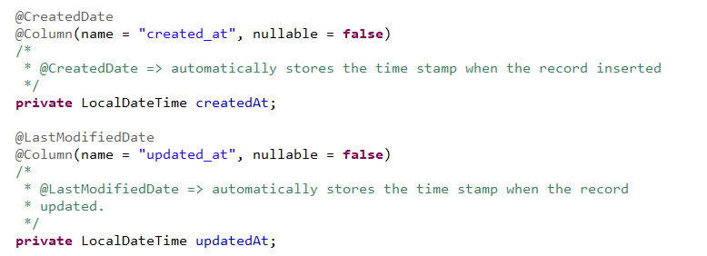
@CreatedDate: Automatically stores the timestamp of when the entity is created. This field is populated when the entity is persisted for the first time.
@LastModifiedDate: Automatically stores the timestamp of when the entity is last modified. This is updated every time the entity is updated.
@Temporal(TemporalType.TIMESTAMP): Used to indicate that the date should be stored with both the date and time. This is essential for LocalDateTime.
@CreatedDate, @LastModifiedDate and @Temporal Annotations

Slide 7
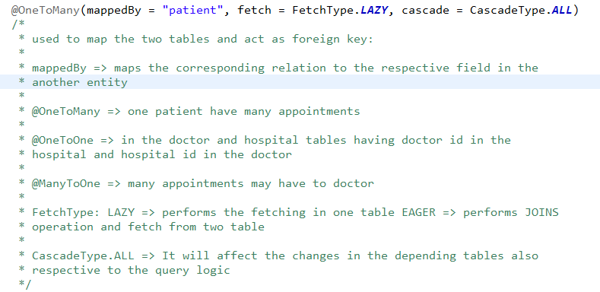
@OneToMany, @ManyToOne, @OneToOne annotations:
@OneToMany: One parent to many children.
@ManyToOne: Many children to one parent.
@OneToOne: One entity associated with one other entity.

Slide 8
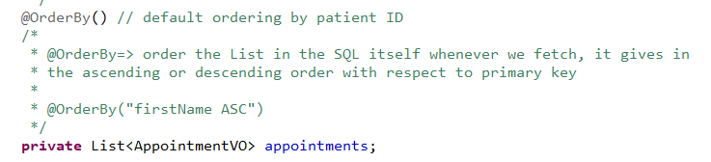
@OrderBy Annotation
Sorts related collections based on a property.
Example: @OrderBy('publicationYear DESC')

Slide 9
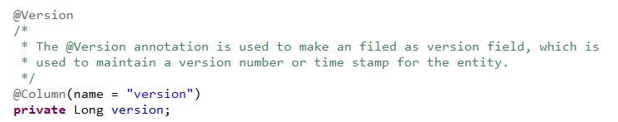
@Version Annotation
Denotes as an Version field.
Tracks changes and prevents concurrent updates.

Slide 10
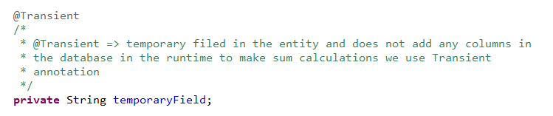
@Transient Annotation
Indicates fields not persisted in the database.
Used for temporary data or non-persistent fields.

Slide 11
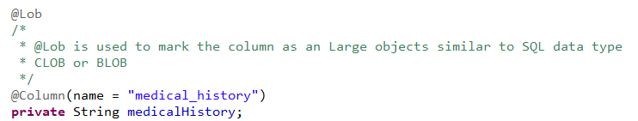
@Lob Annotation
Maps large data objects like BLOBs and CLOBs.
Used for storing large text or binary data.

